Slide 1
2024

Slide 3
1800

Slide 4

Letter Writing

Slide 5
Integrity and Confidentiality were major concerns.
Takes time to get to the destination.
Not suitable for long distances.
Letter Writing

Slide 6
Not suitable for long distances.
Takes time to get to the destination.
Integrity and Confidentiality were major concerns.
Letter Writing

Slide 7
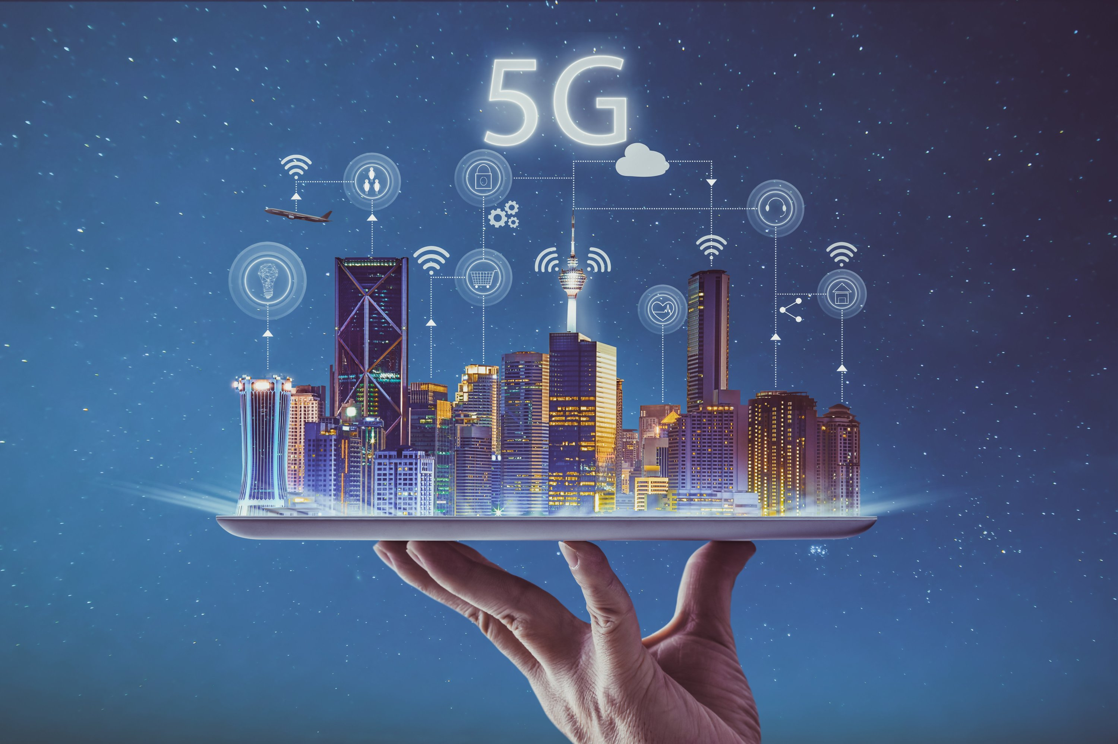
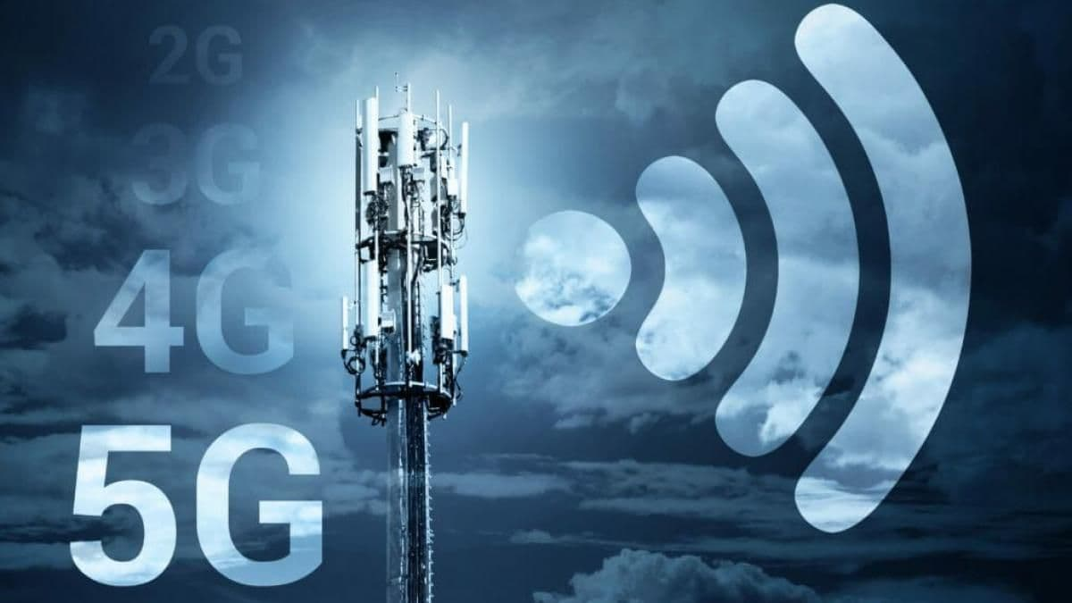
No Connectivity over distances.
Time taking communication methods.
No Medium for any sort of data transfer.
Disadvantages of that time
Internet and Mobile Networks

Slide 8
No Connectivity over distances.
Time taking communication methods.
No Medium for any sort of data transfer.
In 2024, Internet and Mobile Networks
Letter Writing

Slide 9
Time taking communication methods.
In 2024, Internet and Mobile Networks

Slide 10


Slide 11
What is G in Wireless Communication
Presented by:
Haani Bin Qaiser
Muhammad Asim Saleem
Muhammad Abaid
Muhammad Hurraira

Slide 12
What is G in Wireless Communication

Slide 13
What is G in Wireless Communication
G in Wireless communication represent the generation of technology in context of mobile network technology.
These terms refer to the different generations of wireless communication standards,
There have been five generations of cellular networks so far 1G, 2G, 3G, 4G and finally 5G.
Each generation has some advantage over the previous generation regarding speed, efficiency, and latency.

Slide 14
What is G in Wireless Communication
G in Wireless communication represent the generation of technology in context of mobile network technology.
These terms refer to the different generations of wireless communication standards,
There have been five generations of cellular networks so far 1G, 2G, 3G, 4G and finally 5G.
Each generation has some advantage over the previous generation regarding speed, efficiency, and latency.
Types of Mobile Networks

Slide 15
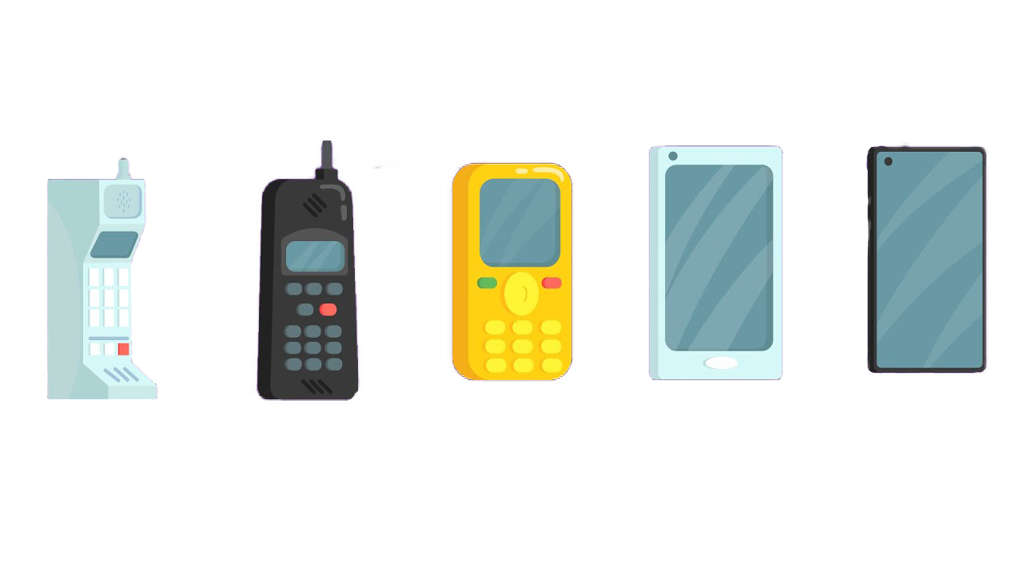
What is G in Wireless Communication
Types of Mobile Networks
These terms refer to the different generations of wireless communication standards,
There have been five generations of cellular networks so far 1G, 2G, 3G, 4G and finally 5G.
G in Wireless communication represent the generation of technology in context of mobile network technology.
Each generation has some advantage over the previous generation regarding speed, efficiency, and latency.
1G
1979
2G
1991
3G
2001
4G
2009
5G
2018
Analog Transmission
Voice Only Communication
Limited Coverage and Capacity
Heavy Mobile Phones
24KBps speed
Digital Transmission
Text Messaging (SMS)
Improved Security
Better Coverage and Capacity
MMS and Internet browsing
64KBps speed
Gradually speed increased to 144KBps
Faster Data Speeds than 2G (>384)
Multimedia Support
Simultaneous Voice and Data
Better Call Quality
Global Roaming
GPS, Mobile Internet, Video Call and streaming were its applications
Faster Data Speeds than 3G (>100MBps)
Low Latency
High Quality voice and video
High speed Internet, Gaming, IoT, Cloud services and conferencing were its applications
Latest Wireless Communication Technology.
Data Speeds Faster than the previous generations (up to 10GBps)
Ultra Low Latency
Massive Connectivity
Improved Efficiency

Slide 16
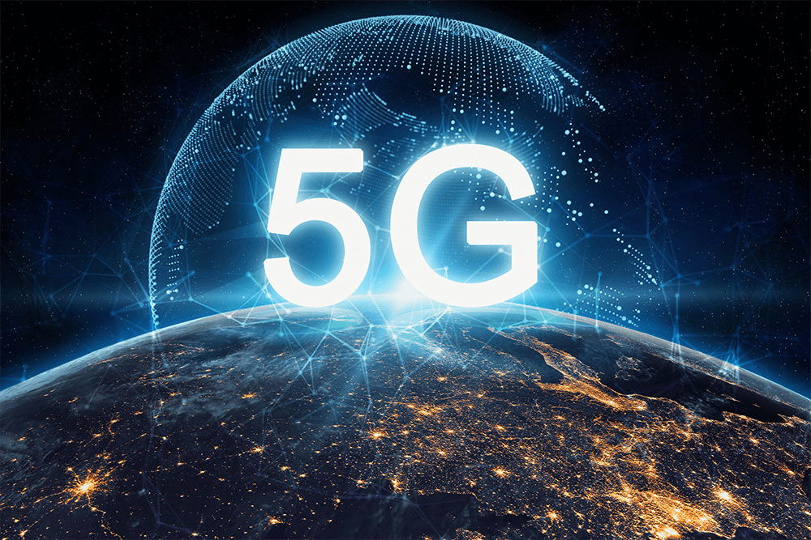
Types of Mobile Networks
1G
1979
2G
1991
3G
2001
4G
2009
5G
2019
5G Network
2019
Digital Transmission
Text Messaging (SMS)
Improved Security
Better Coverage and Capacity
MMS and Internet browsing
64KBps speed
Gradually speed increased to 144KBps
Faster Data Speeds than 2G (>384)
Multimedia Support
Simultaneous Voice and Data
Better Call Quality
Global Roaming
GPS, Mobile Internet, Video Call and streaming were its applications
Analog Transmission
Voice Only Communication
Limited Coverage and Capacity
Heavy Mobile Phones
24KBps speed
Faster Data Speeds than 3G (>100MBps)
Low Latency
High Quality voice and video
High speed Internet, Gaming, IoT, Cloud services and conferencing were its applications
Latest Wireless Communication Technology.
Data Speeds Faster than the previous generations (up to 20GBps)
Ultra Low Latency
Massive Connectivity
Improved Efficiency

Slide 17
Types of Mobile Networks
1G
1979
2G
1991
3G
2001
4G
2009
5G
2019
5G Network
2019
Analog Transmission
Voice Only Communication
Limited Coverage and Capacity
Heavy Mobile Phones
24KBps speed
Digital Transmission
Text Messaging (SMS)
Improved Security
Better Coverage and Capacity
MMS and Internet browsing
64KBps speed
Gradually speed increased to 144KBps
Faster Data Speeds than 2G (>384)
Multimedia Support
Simultaneous Voice and Data
Better Call Quality
Global Roaming
GPS, Mobile Internet, Video Call and streaming were its applications
Faster Data Speeds than 3G (>100MBps)
Low Latency
High Quality voice and video
High speed Internet, Gaming, IoT, Cloud services and conferencing were its applications
Latest Wireless Communication Technology.
Data Speeds Faster than the previous generations (up to 20GBps)
Ultra Low Latency
Massive Connectivity
Improved Efficiency

Slide 18
Types of Mobile Networks
4G
2009
3G
2001
2G
1991
1G
1979
5G Network
2019
Faster Data Speeds than 2G (>384)
Multimedia Support
Simultaneous Voice and Data
Better Call Quality
Global Roaming
GPS, Mobile Internet, Video Call and streaming were its applications
Analog Transmission
Voice Only Communication
Limited Coverage and Capacity
Heavy Mobile Phones
24KBps speed
Faster Data Speeds than 3G (>100MBps)
Low Latency
High Quality voice and video
High speed Internet, Gaming, IoT, Cloud services and conferencing were its applications
Digital Transmission
Text Messaging (SMS)
Improved Security
Better Coverage and Capacity
MMS and Internet browsing
64KBps speed
Gradually speed increased to 144KBps
Latest Wireless Communication Technology.
Data Speeds Faster than the previous generations (up to 10GBps)
Ultra Low Latency
Massive Connectivity
Improved Efficiency

Slide 19

Types of Mobile Networks
Advantages Over
Previous Generations:
Introduction:
It is the Latest Telecommunication technology
Introduced in 2019
South Korea was the first the first country to widely adopt 5G network in April 2019.
Samsung, Huawei, Nokia etc, have contributed in the development of 5G.
China has the largest number of 5G base stations.
Faster Data Speed (20GBps)
Ultra Low Latency (1ms)
Ultra Low Latency (1ms)
Can connect 1 Million Devices over a square kilometer radius

Slide 20
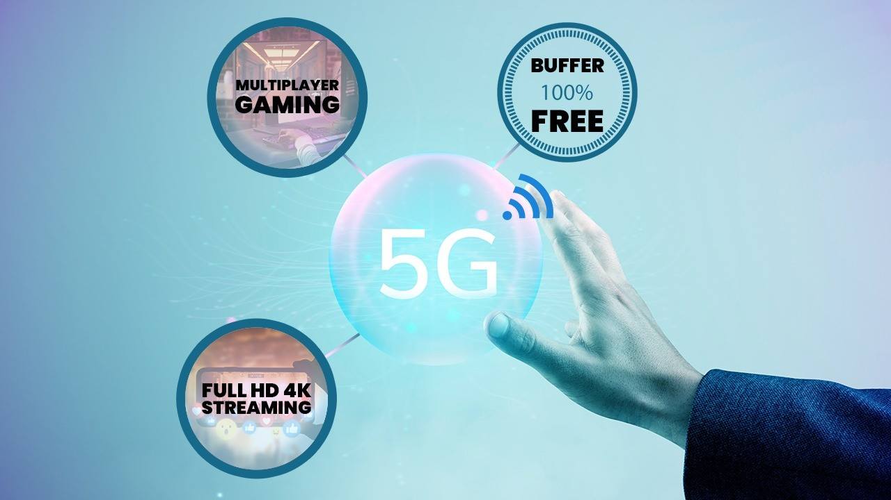
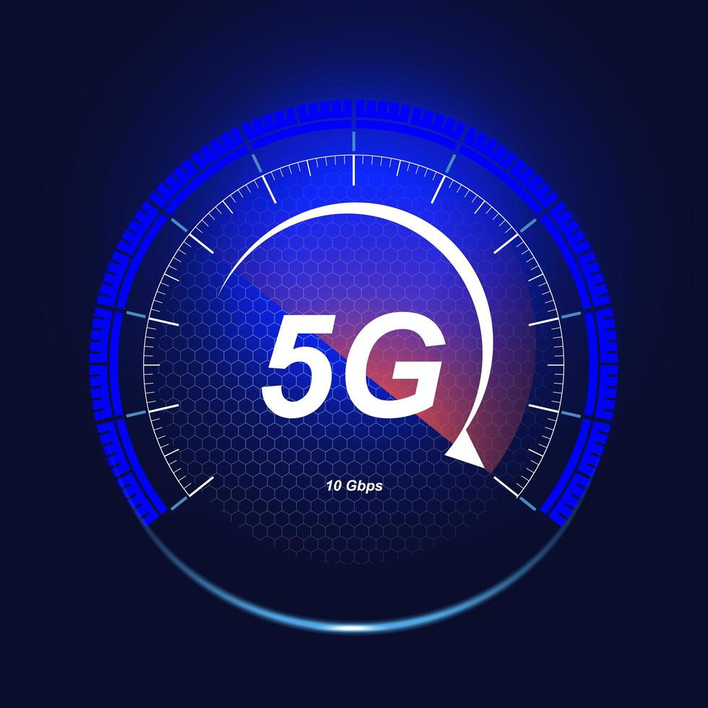
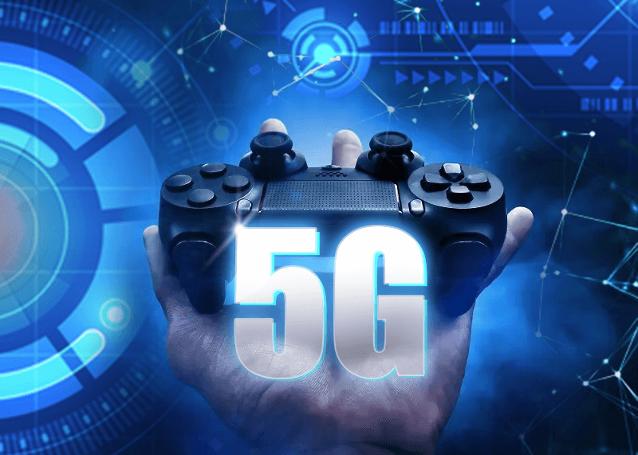
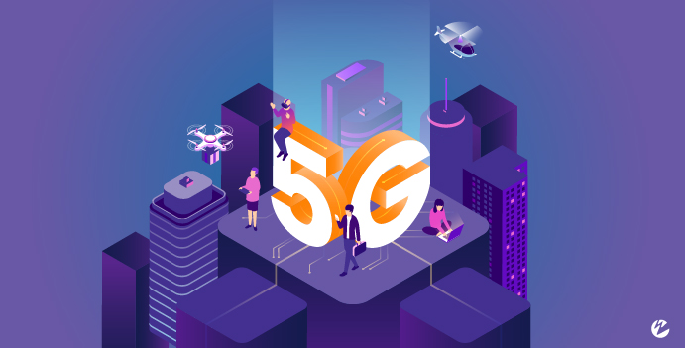
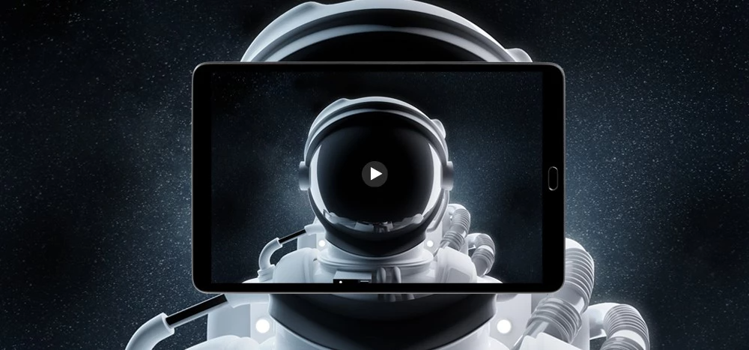
Advantages Over
Previous Generations:
Faster Data Speed (20GBps)
Ultra Low Latency (1ms)
Introduction:
Introduced in 2019
South Korea was the first the first country to widely adopt 5G network in April 2019.
Samsung, Huawei, Nokia etc, have contributed in the development of 5G.
China has the largest number of 5G base stations.
Can connect 1 Million Devices over a square kilometer radius
Reliable and Convenient
Much better than Previous generations.

Slide 21
Advantages Over
Previous Generations:
Faster Data Speed (20GBps)
Ultra Low Latency (1ms)
Can connect 1 Million Devices over a square kilometer radius
Introduction:
Introduced in 2019
South Korea was the first the first country to widely adopt 5G network in April 2019.
Samsung, Huawei, Nokia etc, have contributed in the development of 5G.
China has the largest number of 5G base stations.
Fast Downloading
High Speed Multimedia
Streaming
Ultra Low Latency
Gaming
Best Coverage and Connectivity

Slide 22




Advantages Over
Previous Generations:
Faster Data Speed (20GBps)
Ultra Low Latency (1ms)
Can connect 1 Million Devices over a square kilometer radius
Applications Of 5G:
And Many More
Online Gaming
AI Technologies
VR/AR Technology
Video Conferencing
Ultra Low Latency
Gaming
High Speed Multimedia
Streaming
Fast Downloading
Best Coverage and Connectivity

Slide 23
Advantages Over
Previous Generations:
Faster Data Speed (20GBps)
Ultra Low Latency (1ms)
Can connect 1 Million Devices over a square kilometer radius
Applications Of 5G:
In the Realm of ICT, 5G technology enables a wide range of applications such as enhanced mobile bandwidth, Ultra reliable low latency communication, smart manufacturing, Virtual Reality, Artificial Intelligence, Video Conferencing Rooms etc.
Some Key Application fields of 5G in ICT are:
Consumer Applications
Industrial Applications
HealthCare Applications
Transportation Applications
Public Safety Applications
In Information And Communication Technology:
Online Gaming
AI Technologies
And Many More
VR/AR Technology
Video Conferencing
Best Coverage and Connectivity

Slide 24

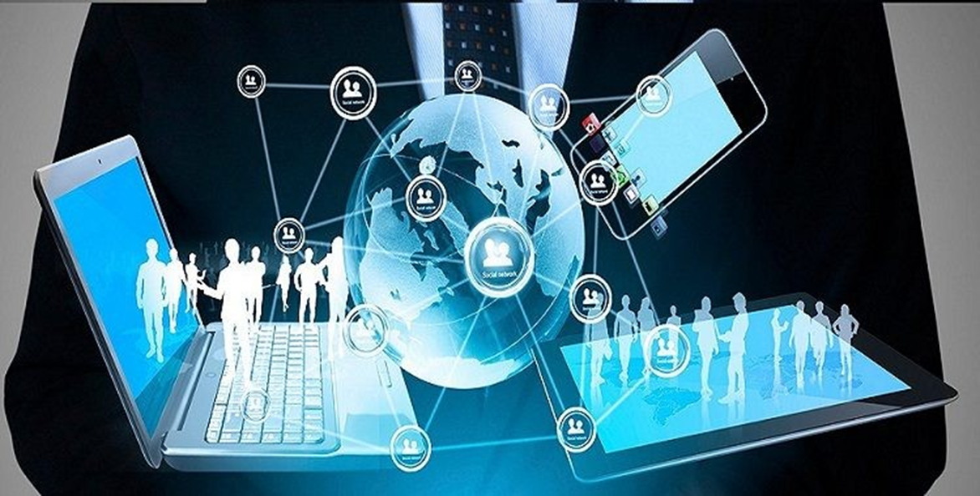
Applications Of 5G:
Smart Manufacturing:
Real Time Machine Monitoring
Robot Control
Automated guided Vehicles
Quality Inspection
In Information And Communication Technology:
Critical Infrastructure Monitoring:
Power Grid Monitoring
Smart Grid
IIoT:
Massive Device Connectivity
Edge Computing
VR and AR:
Training and Instructions
Assembly Guidance
In the Realm of ICT, 5G technology enables a wide range of applications such as enhanced mobile bandwidth, Ultra reliable low latency communication, smart manufacturing, Virtual Reality, Artificial Intelligence, Video Conferencing Rooms etc.
Some Key Application fields of 5G in ICT are:
Industrial Applications
HealthCare Applications
Public Safety Applications
AI Technologies
Online Gaming
And Many More
Video Conferencing
VR/AR Technology

Slide 25
Industrial Applications of 5G in ICT
Applications Of 5G:
In Information And Communication Technology:
Smart Manufacturing:
Real Time Machine Monitoring
Robot Control
Automated guided Vehicles
Quality Inspection
VR and AR:
Training and Instructions
Assembly Guidance
IIoT:
Massive Device Connectivity
Edge Computing
Critical Infrastructure Monitoring:
Power Grid Monitoring
Smart Grid
In the Realm of ICT, 5G technology enables a wide range of applications such as enhanced mobile bandwidth, Ultra reliable low latency communication, smart manufacturing, Virtual Reality, Artificial Intelligence, Video Conferencing Rooms etc.
Some Key Application fields of 5G in ICT are:
Industrial Applications
HealthCare Applications
Public Safety Applications
AI Technologies
Online Gaming
And Many More
Video Conferencing
VR/AR Technology

Slide 26
HealthCare Applications of 5G in ICT
Remote Patient Monitoring:
Real time video consultation
Continuous Monitoring
Rural Healthcare access
IoMT:
Connected Medical devices
Hospital asset tracking
Smart Hospital ecosystems
VR and AR:
Medical Training
Remote Surgeries
Robotics in Healthcare:
Surgical Robots
Robotic Assistance
AI based medicine Assistance
VR Therapy

Slide 27
Consumer Applications of 5G in ICT
Remote Services and Entertainment:
Video/Cloud Conferencing
Cloud Computing
Interactive Content
Personalized Experiences
IoT:
Smart Home Integration
Wearables
Minimal lag for real time control
VR and AR:
Immersive Experiences
Education and Training
Smart Vehicles and Cities:
Autonomous driving
Public services
Emergency Services

Slide 28
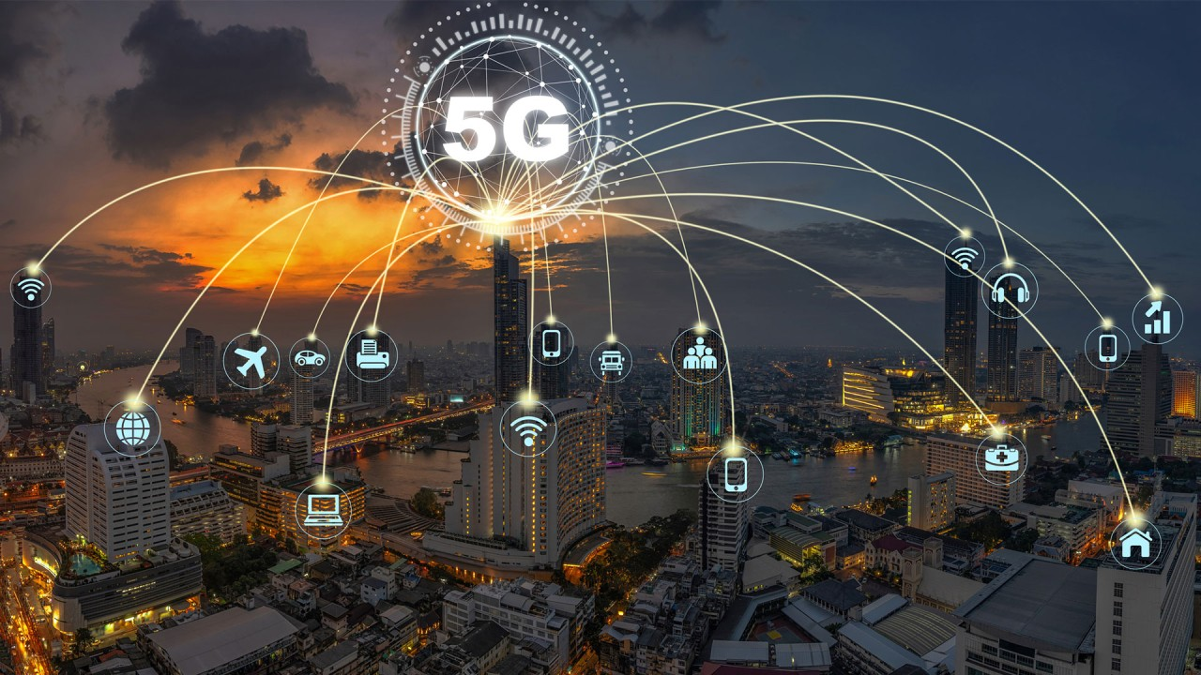
Consumer Applications of 5G in ICT

Slide 29
5G is expected to perform far more better than 4G Technology.
5G is expected to be 90% more efficient per bit than 4G in the near future.

Slide 30
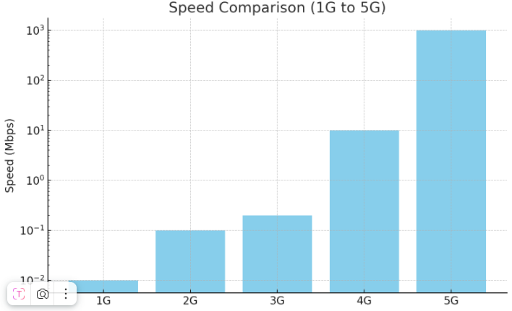
Speed Difference Between Generations:
5G is expected to perform far more better than 4G Technology.
5G is expected to be 90% more efficient per bit than 4G in the near future. 5G adoption is expected to grow 70% in about 2027.

Slide 31
5G is expected to perform far more better than 4G Technology.
Speed Difference Between Generations:
5G is expected to be 90% more efficient per bit than 4G in the near future.

Slide 32
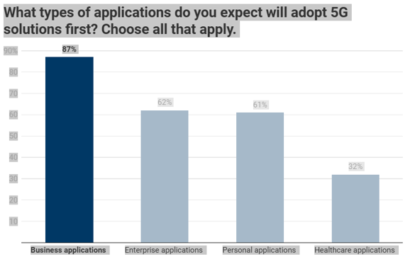
Expected 5G applications percentages in the near future
Speed Difference Between Generations:

Slide 33
Current 5G Infrastructure and Expense Distribution Chart
Expected Market share of 5G applications:
Expected 5G applications percentages in the near future
Speed Difference Between Generations:
6G Network:
6G network is expected to have greater speed, less latencyand much mor improved connectivity as compared to 5G network. It will introduce new applications. It is the future successor of 5G. It is expected that 6G will be introduced somewhere around 2030s.

Slide 34
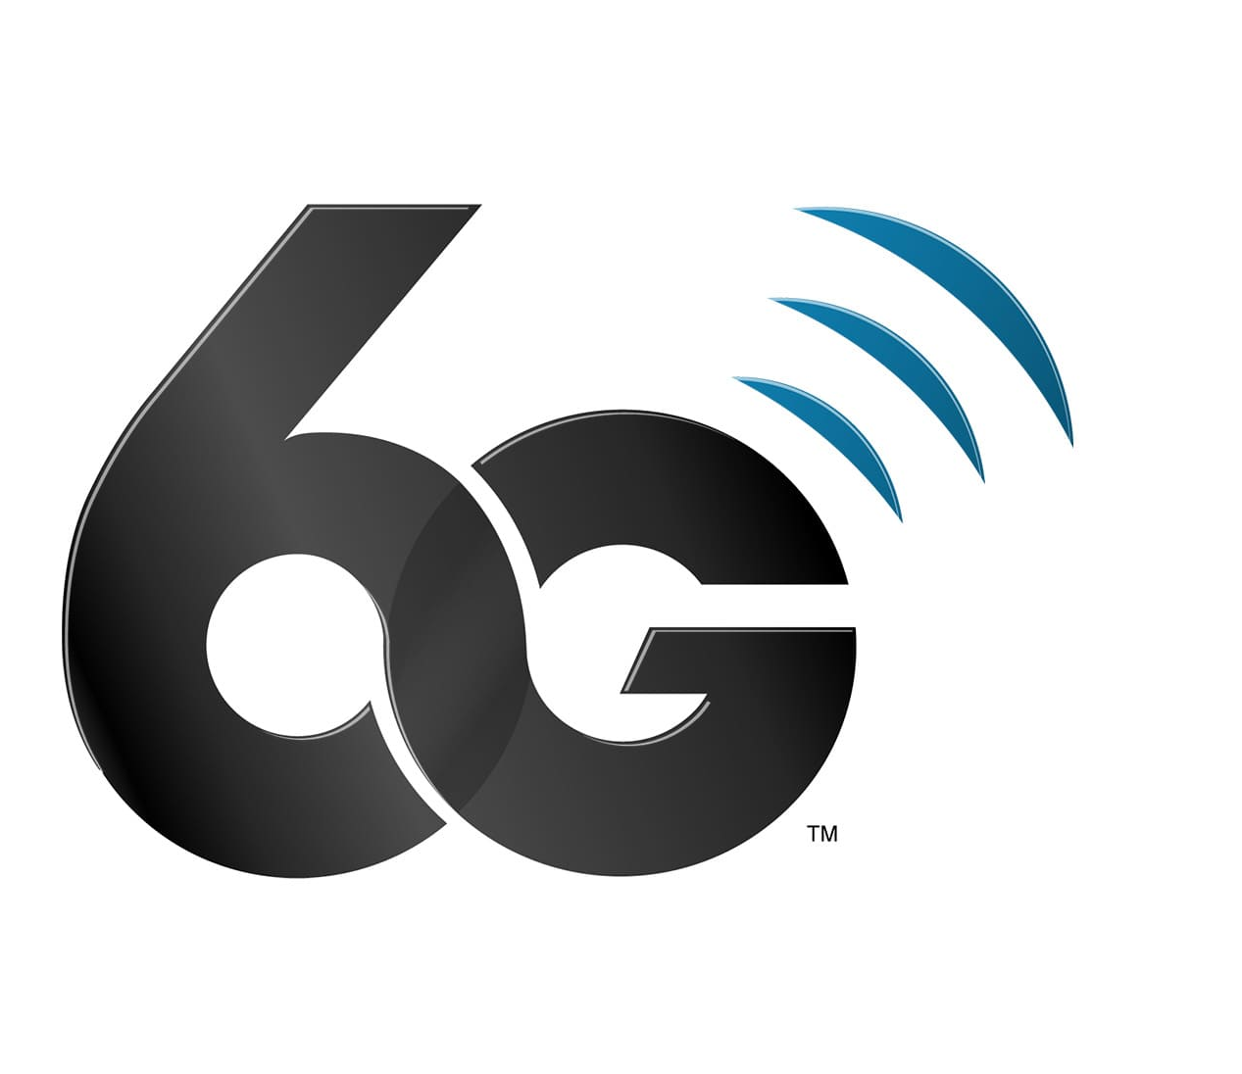
Expected Market share of 5G applications:
Current 5G Infrastructure and Expense Distribution Chart
Expected 5G applications percentages in the near future
Speed Difference Between Generations:
6G Network:
6G network is expected to have greater speed, less latencyand much mor improved connectivity as compared to 5G network. It will introduce new applications. It is the future successor of 5G. It is expected that 6G will be introduced somewhere around 2030s.

Slide 35
Expected 5G applications percentages in the near future
Speed Difference Between Generations:
6G Network:
6G network is expected to have greater speed, less latencyand much mor improved connectivity as compared to 5G network. It will introduce new applications. It is the future successor of 5G. It is expected that 6G will be introduced somewhere around 2030s.

Slide 37
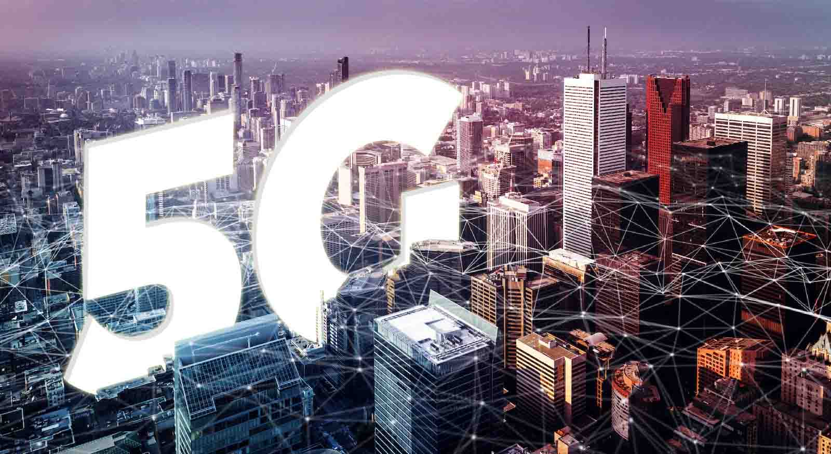
Infrastructure Requirements:
Extensive new infrastructure
Deployment is Time consuming
Expensive
Security and Privacy:
More devices connected to the internet
More security will be required
Anti-hacking system must be deployed
Digital Divide:
People living in rural and under developed regions will require access to 5G network, which is considered difficult in these areas
Energy Consumption:
5G network requires a lot of energy consumption
Energy consumption of 5G is much more greater than 4G

Slide 38
Health and Environment Concerns:
Increased radio frequency exposure
Environment will be affected
Regulatory and Policy Concern:
Government Approvals
Legal Challenges
Adoption and Awareness:
Consumer Hesitation
Enterprise Integration
Technological Concerns:
Device Compatibility
Backwards Compatibility
Latency Optimization

Slide 39
Conclusion:
The 5G Network Technology is a new emerging technology. It is an intrusting technology to study. We Hope that this will soon become the standard of Mobile Networking and will be popular among people.
Health and Environment Concerns:
Increased radio frequency exposure
Environment will be affected
Regulatory and Policy Concern:
Government Approvals
Legal Challenges
Adoption and Awareness:
Consumer Hesitation
Enterprise Integration
Technological Concerns:
Device Compatibility
Backwards Compatibility
Latency Optimization

Slide 40

Any Queries?

